Slide 1

Predicting Weather Conditions
Machine Learning Analysis - ClimateWins
Kyle Stanford
09/09/2024

Slide 2
Agenda
1. Objectives & Hypotheses
2. Data Sets & Data Bias
3. Data Optimisation
4. Supervised Machine Learning
5. Scaling and Model Performance
6. Conclusion & Future Steps

Slide 3
Objectives
ClimateWins wants to know if machine learning can be used to predict picnic suitability based on weather data from various stations.
Hypotheses
ANN models will outperform KNNs and Decision Trees because they’re more complex.
Some weather station data may be unsuitable for predictions due to data quality restraints.
Scaling the data will significantly improve the performance of machine learning models.
Notes:
ClimateWins current goal is to simply assess whether machine learning tools can be used to predict the weather. The hope that if machine learning proves useful, it may have applications in predicting and planning for the consequences of climate change and extreme weather events. ClimateWins also hopes, it ML proves useful for this data, that the consequences of climate change can be predicted around the world.

Slide 4

Data Set
Data Bias
Data was collected by the European Climate Assessment & Data Set Project.
Daily weather metrics (temperature, precipitation, wind speed, etc) from 18 weather stations across Europe.
Data ranges from 1960 to 2022.
Data Link
Secondary data set – picnic suitability data.
Sampling Bias: Only 18 of the 23755 weather stations throughout Europe and the Mediterranean have been included. This could misrepresent climate patterns, thus impacting any analyses.
Measurement Bias:
Changes to measurement tools/methods
Human subjectivity in determining “pleasant weather”

Slide 5
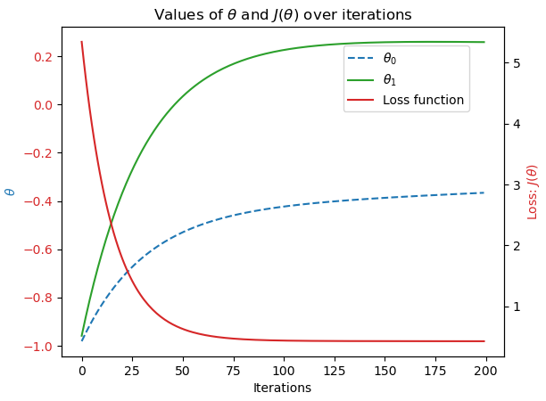
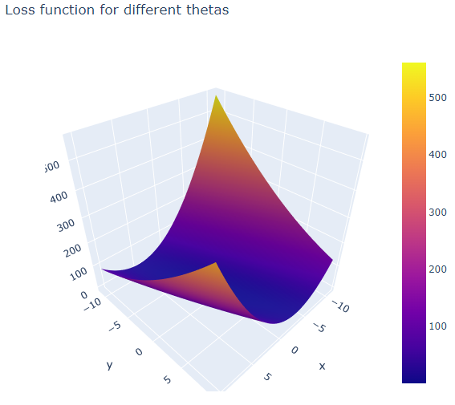
Data Optimisation
Gradient descent was applied to temperature data from various weather stations across different years.
Finds parameters for the best-fit line or curve that minimises the cost function (error between predicted and actual values).
Cost function approached zero (approx. 0.5) in all cases, meaning the data could be approximated accurately.
Notes:
It was important to use data optimisation techniques to understand whether the data being used would work well with machine learning techniques.
Gradient descent was applied to the average daily temperature data from 3 weather stations across different years to determine this. Gradient descent was used because it is one of the simplest optimisation techniques for finding a local minimum and can be used for linear and non-linear data. It works by finding the parameters of a function that minimises its cost function (essentially the difference between the functions predicted values and the data’s actual values).
It was found here that gradient descent converged in all cases. That is, the cost function trended towards zero – but was typically off by about 0.5 to 0.6. This was achieved by playing with the number or iterations, starting parameters and alpha (learning rate / step size).

Slide 6


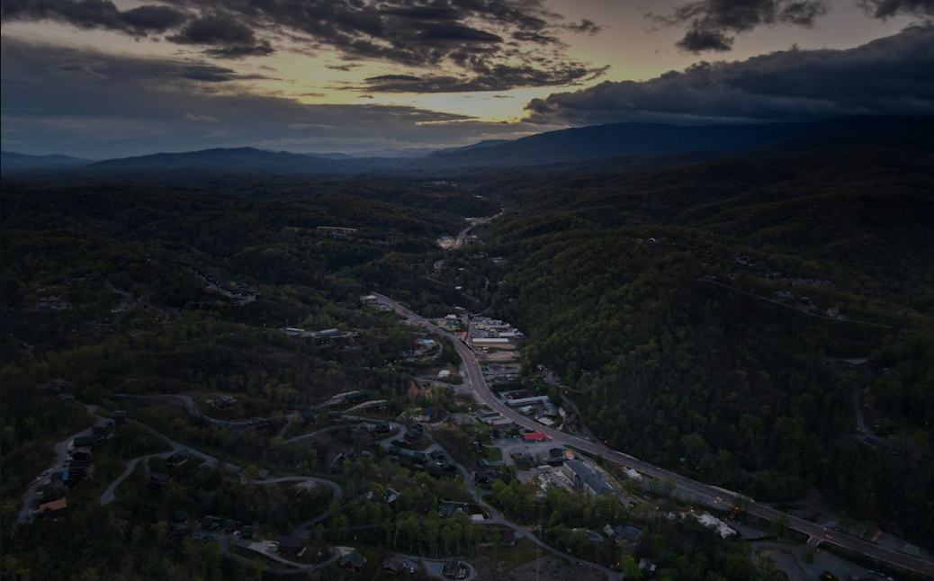
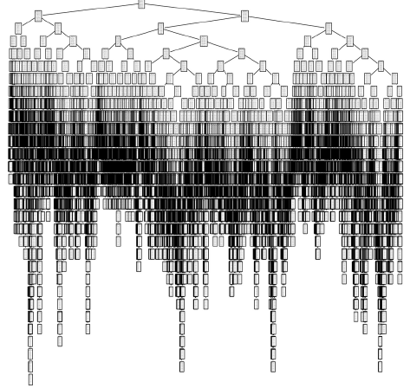
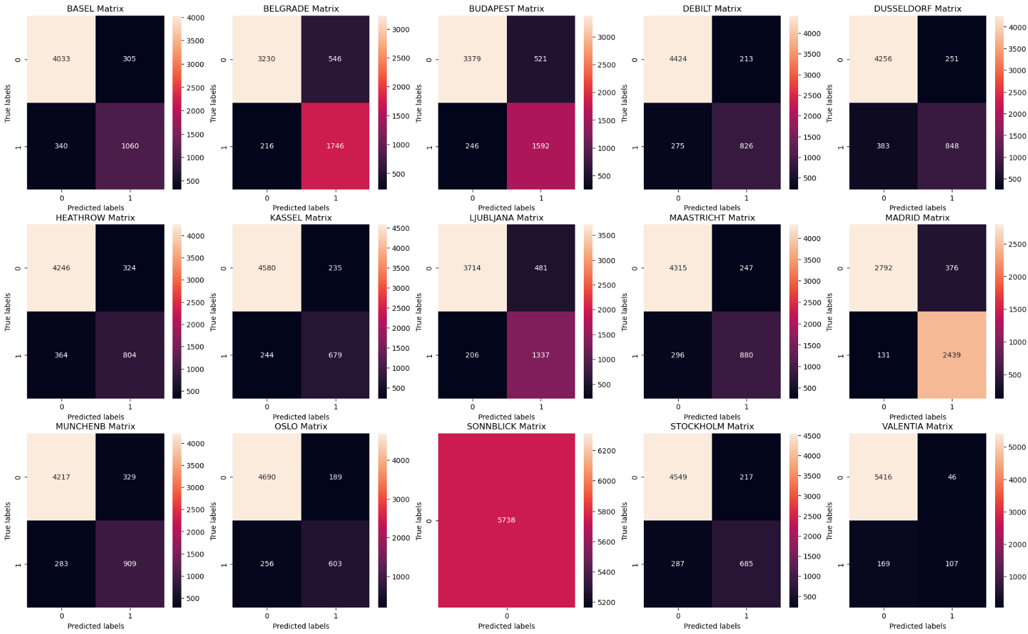
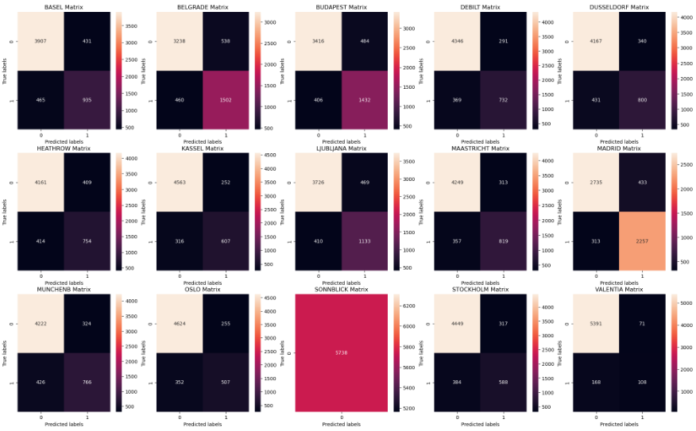
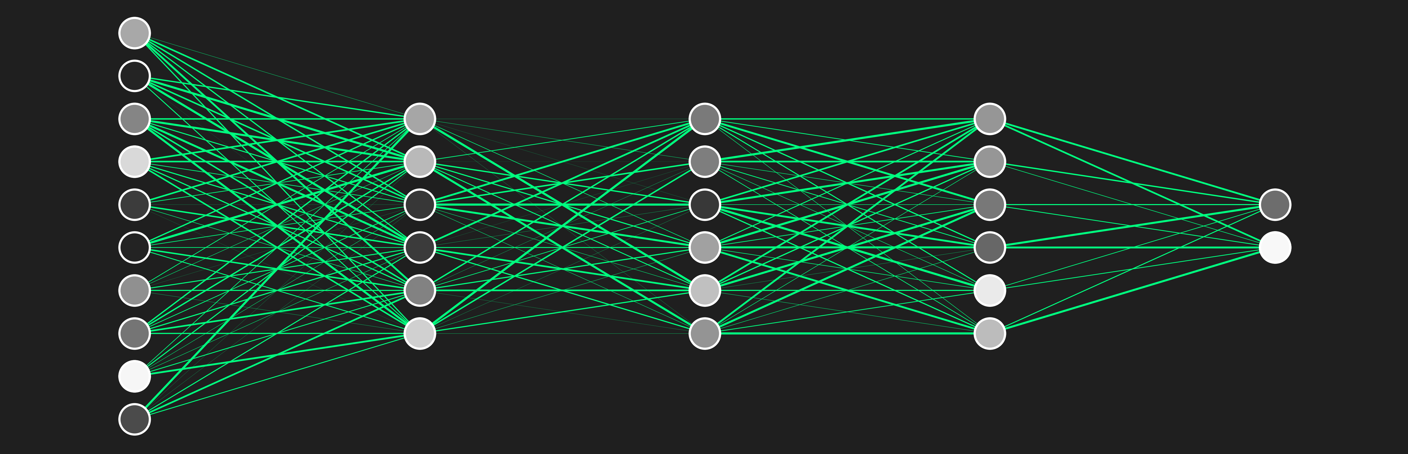
Supervised Machine Learning
K-Nearest Neighbours
ANNs were used to classify our weather data by processing data points through layers of neurons.
Multiple combinations of neuron layers and neuron totals were trialled.
KNN was used to classify a given day’s weather data as pleasant or unpleasant by comparing data points to their closest neighbouring points and the category to which they belonged.
Decision Trees make predictions of data points by asking multiple questions – sorting the data like a flowchart.
Our decision tree overfit the training data.
Confusion Matrix: KNN Testing Data
Decision Tree made during project
Confusion Matrix: ANN Testing Data
Average Accuracy Scores
Training Data: 93.91 %
Testing Data: 88.15 %
Notes:
Remember to state that the data being used from the main weather data set are only the average daily temperature columns.
K-Nearest Neighbour is a classification-based algorithm that uses the proximity between data points to categorise data points or make predictions about which group a data point belongs to.

Slide 7
Supervised Machine Learning
Decision Tree Model
ANNs were used to classify our weather data by processing data points through layers of neurons.
Multiple combinations of neuron layers and neuron totals were trialled.
KNN was used to classify a given day’s weather data as pleasant or unpleasant by comparing data points to their closest neighbouring points and the category to which they belonged.
Decision Trees make predictions of data points by asking multiple questions – sorting the data like a flowchart.
Our decision tree overfit the training data.
Confusion Matrix: KNN Testing Data
Decision Tree made during project
Confusion Matrix: ANN Testing Data
Average Accuracy Scores
Training Data: 100 %
Testing Data: 87.14 %
Notes:
The decision tree is composed of a root node, branches, internal nodes, and leaf nodes. The decision tree generated in this analysis certainly overfit the data, as the training data set was 100% accurate. The test data set was 47.77% accurate.

Slide 8
Supervised Machine Learning
Artificial Neural Network
ANNs were used to classify our weather data by processing data points through layers of neurons.
Multiple combinations of neuron layers and neuron totals were trialled.
KNN was used to classify a given day’s weather data as pleasant or unpleasant by comparing data points to their closest neighbouring points and the category to which they belonged.
Decision Trees make predictions of data points by asking multiple questions – sorting the data like a flowchart.
Our decision tree overfit the training data.
Confusion Matrix: KNN Testing Data
Decision Tree made during project
Confusion Matrix: ANN Testing Data
Average Accuracy Scores
Training Data: 91.37 %
Testing Data: 91.04 %
Notes:
Finally, ANNs are made of layers of nodes/neurons. Each connect to others, making decisions about multiplying inputs by various weights and adding biases before passing on a certain amount of data onto the next node.

Slide 9
Did Scaling Matter?
Scaled Data
Unscaled Data
KNN:
Training Accuracy: 93.91%
Training Accuracy: 94.02%
Scaling is extremely important.
In this case, scaling had minimal impact since the columns were all related to temperature.
The models’ performances, using unscaled data, would likely be diminished by training each with additional weather metrics.
Testing Accuracy: 88.15%
Testing Accuracy: 88.45%
Decision Tree:
Training Accuracy: 100%
Training Accuracy: 100%
Testing Accuracy: 87.14%
Testing Accuracy: 87.23%
ANN:
Training Accuracy: 91.37%
Training Accuracy: 91.32%
Testing Accuracy: 91.04%
Testing Accuracy: 91.04%

Slide 10
Model Evaluation?
KNN:
The KNN model performs generally well.
Was relatively easy to set up and implement due to having only a few hyperparameters.
May be difficult to scale to larger data sets.
Training Accuracy: 93.91%
Testing Accuracy: 88.15%
Decision Tree:
Clear case of overfitting.
There may be a case for using this type of model, but branches will need to be pruned so it can generalise to new data effectively.
Training Accuracy: 100%
Testing Accuracy: 87.14%
ANN:
The best performing model.
Required the most fine-tuning and experimentation.
Efficient once trained and extremely useful for complex and high-dimensional data.
Training Accuracy: 91.37%
Testing Accuracy: 91.04%

Slide 11
Limitations
All models have been trained on an unbalanced data (picnic suitability).
Sonnblick stations weather data was completely unbalanced.
Bias towards the majority class.
Difficulty in learning minority class patterns.
Inflates overall accuracy score.
Model is completely ungeneralisable to new data.

Slide 12
Conclusions & Future Steps
Overall, machine learning models show promise in predicting climate patterns but should be further explored and experimented with.
KNN:
Decision Tree:
ANN:
KNN results were promising and would work well with data of similar size and dimensionality.
However, much larger datasets or those with many extra features should be avoided.
Decision trees could be great if steps are taken to reduce the overfitting issue:
Prune branches from the model to simplify categorisation.
Use ensemble methods like Random Forests.
Best performing model.
Despite its “black-box” nature, it is scalable and may work even better in more complex data with more features.
Avoid use in small datasets due to risk of overfitting.

Slide 13
Questions?

